Slide 1
0x204 – Protocols and Common Signals When Probing
ECED4406
Dr. Colin O’Flynn
Dalhousie University

Slide 2
Signals We Will Cover
Logic Levels
Asynchronous Serial
SPI
I2C
Differential
See Chapter 2 of the Hardware Hacking Handbook for more details on many of these.

Slide 3
Logic Levels?
TX
RX

Slide 4

Logic Levels?
TX
RX

Slide 5

Logic Levels?
TX
RX

Slide 6
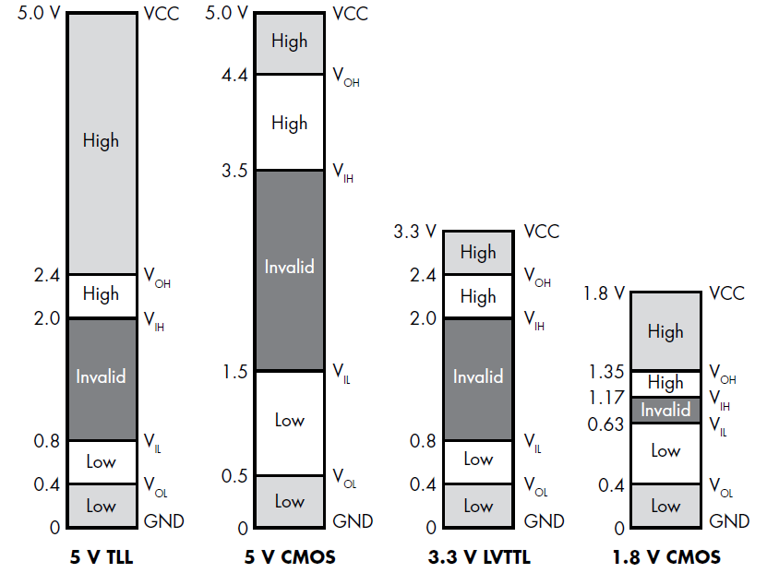
Figure 2-3, HHH

Slide 7
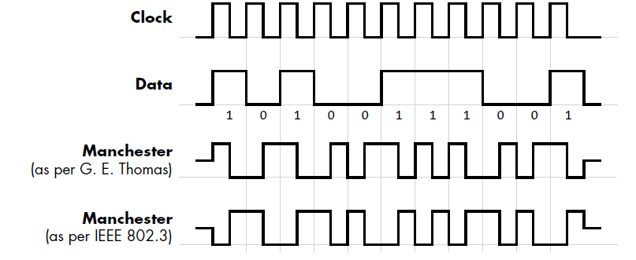
Synchronous & Asynchronous

Slide 8
Synchronous & Asynchronous
Synchronous: Data is sent relative to a clock which is common to the sender & receiver.
NOTE: “Common” could mean it’s transmitted from one to the other, or both have a shared clock somewhere.
Asynchronous: Sender & Receiver maintain their own clock. Some known “timing” information is part of the configuration to define when data is read.

Slide 9
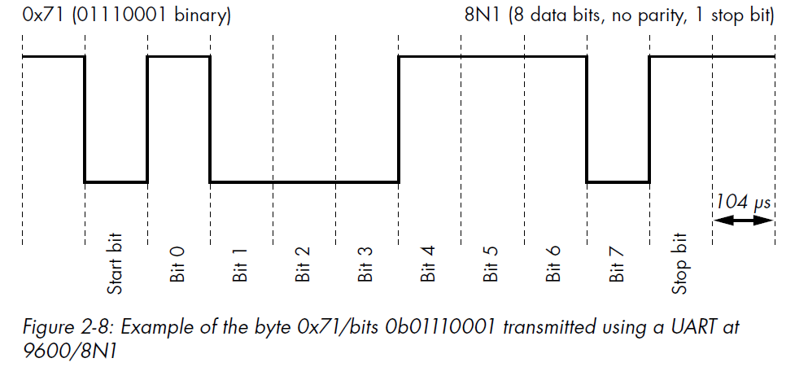
Asynchronous Serial = USART / UART / Serial / RS-232

Slide 10
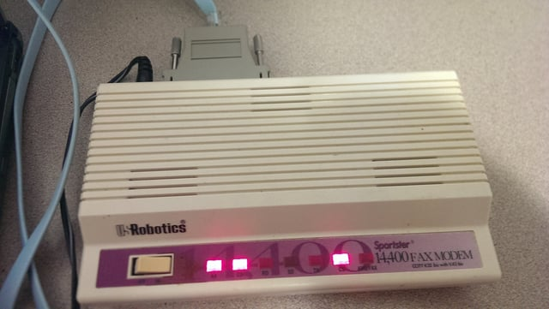
Naming?
Classically serial was used for terminal interfaces to computers, along with modems. This would normally be RS-232

Slide 11
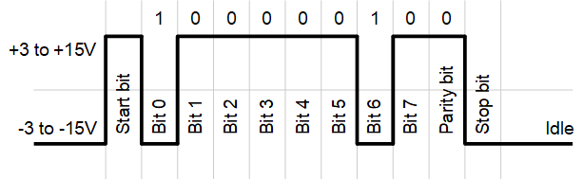
RS-232
“Space” (0)
“Mark” (1)
Source: https://www.anticyclone-systems.co.uk/rs232.php

Slide 12
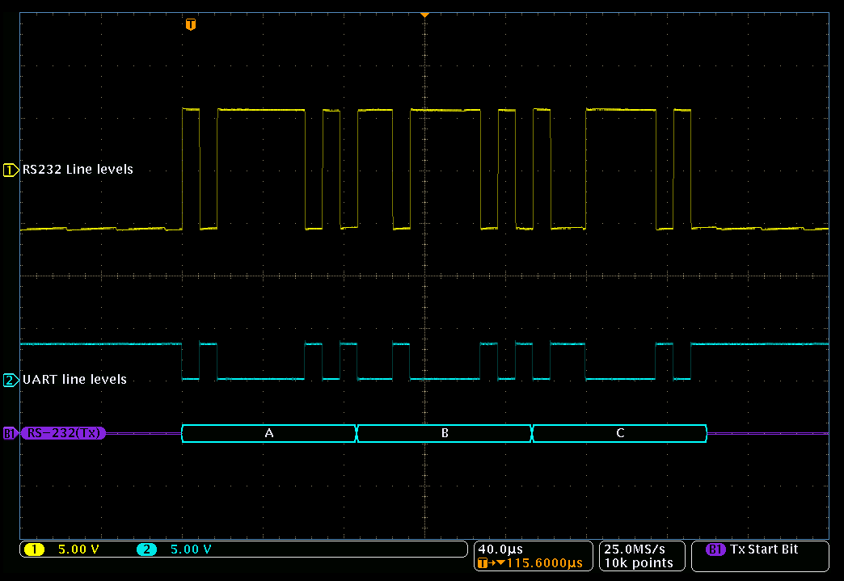
RS-232 vs “TTL” Serial
Source: https://www.anticyclone-systems.co.uk/rs232.php

Slide 13
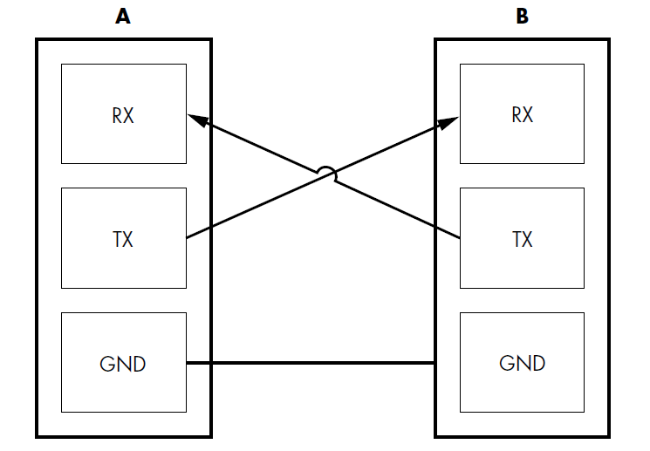
Serial Data Lines

Slide 14
Serial Parameters
Commonly Defined:
Baud Rate
Parity
Stop Bits
Less Commonly Changed:
Bits per character (normally 8, 7/8/9 possible)
Start bits (normally 1)

Slide 16
Baud Rate Notes
Technically any baud rate is possible & valid
9600, 14400, 38400, 57600, 115200, 230400 bps are the most likely
Of those, 9600, 57600, and 115200 are the most common (no proof)
9600 is very slow & typically used by much older devices
115200 is a standard console terminal baud rate
NOTE: You do occasionally see very fast serial baud rates, 1-2 Mbps for example

Slide 17
SPI – Serial Peripheral Interface
Synchronous Protocol, 4 wires:
Data Out
Data In
Clock
Chip Select
(+ Ground of course)

Slide 18
Data Line Names
Controller
Controller Out, Peripheral In (COPI)
Peripheral
Data Out
Data In
Data In
Controller In, Peripheral Out (CIPO)
Data Out
Serial Clock (SCK)
Clock
Chip Select
Clock
Chip Select
Chip Select (CS)
COPI may also be called MOSI
CIPO may also be called MISO
SCK may also be called CLK
CS may also be called SS
Chip Select is almost always active low:
/CS or CS
How we often designate active low signals

Slide 19
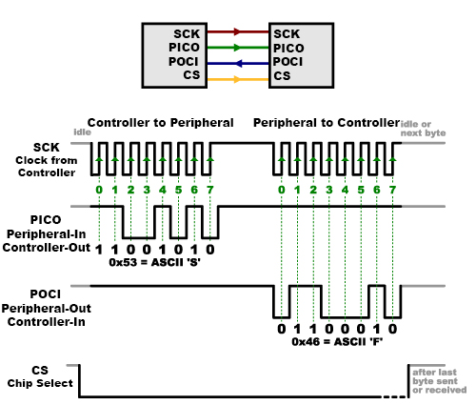
SPI Example:
NOTE: As shown here, there are various names used for same thing
COPI = PICO = MOSI
CIPO = POCI = MISO
https://learn.sparkfun.com/tutorials/serial-peripheral-interface-spi/all

Slide 20
SPI Parameters
Common:
Baud rate (frequency)
Mode
(Much) Less Common:
Bits per character (almost always 8)

Slide 21
SPI Baud Rates
Because SPI is synchronous to an included clock, there is no standard baud rate
Typically runs at > 1 MHz (but not guaranteed)
SPI flash chips can run at > 100 MHz, require high speed to get data out quickly!

Slide 22
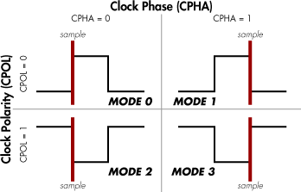
SPI Modes
NOTE: CPOL=1 defines also the idle state of the clock.
SIDENOTE on exam/quiz expectations: I would never expect you to memorize these modes – you would always have the reference material available in real life. I’d expect you to remember different modes exist for sampling however, and that you might need to go look up which mode is being used by the device.

Slide 23
SPI Packet Format
There is no standard format for data itself.

Slide 24
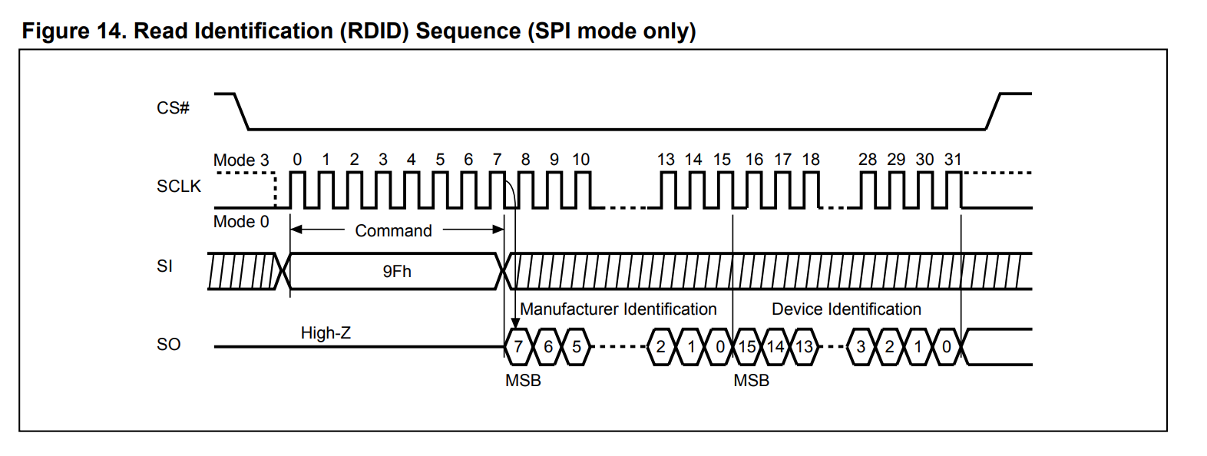
Example: SPI Flash Chip 1
https://www.macronix.com/Lists/Datasheet/Attachments/8800/MX25L25773G,%203V,%20256Mb,%20v1.0.pdf

Slide 25
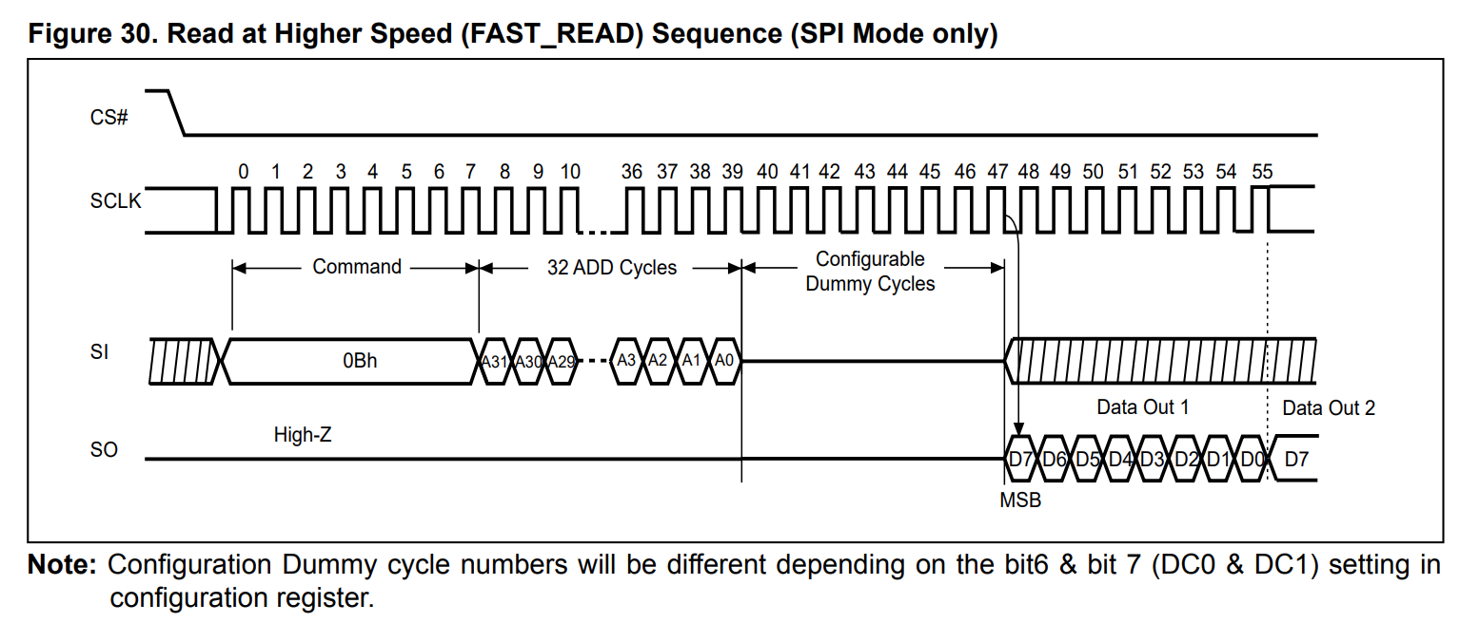
Example: SPI Flash Chip 2
https://www.macronix.com/Lists/Datasheet/Attachments/8800/MX25L25773G,%203V,%20256Mb,%20v1.0.pdf

Slide 26
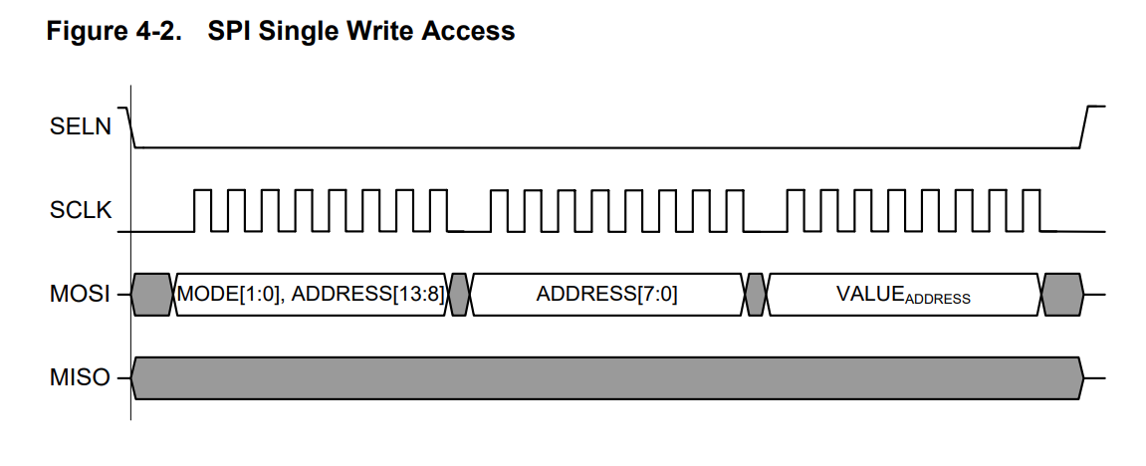
Example: SPI Peripheral Chip Write
https://ww1.microchip.com/downloads/en/devicedoc/atmel-42415-wireless-at86rf215_datasheet.pdf

Slide 27
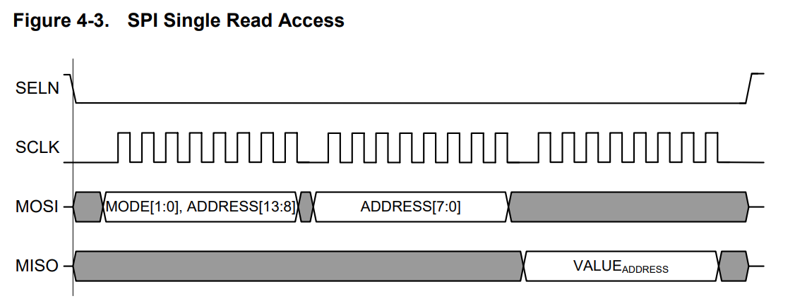
Example: SPI Peripheral Chip Read
https://ww1.microchip.com/downloads/en/devicedoc/atmel-42415-wireless-at86rf215_datasheet.pdf

Slide 28
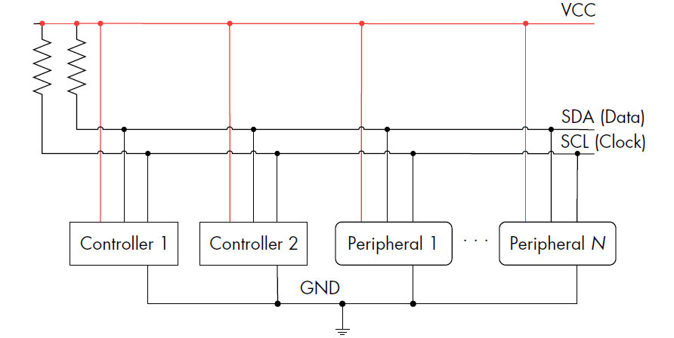
I2C / I²C / TWI

Slide 29
I2C Notes
Note idle state is high
Typical ~2.2K-ohm pull-up resistor on the bus
Baud rate is typically defined as one of:
100 Kbps (SCL = 100 KHz) => “Standard” mode
400 Kbps (SCL = 400 KHz) => “Fast” mode
1 Kbps (SCL = 1 MHz) => “Fast Plus” mode
…other speeds available
Most peripherals support standard mode at minimum.

Slide 30

What’s in a Name?
Inter-IC = IIC = I²C
Due to concern over trademark rules, Atmel used the name Two Wire Interface (TWI) for their I2C interface
Unlike SPI, I2C has a standard packet format with addressing

Slide 31
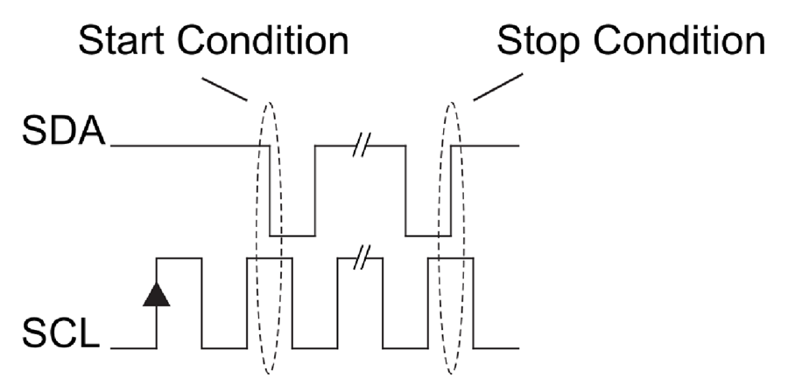
Building an I2C Packet
https://www.analog.com/en/resources/technical-articles/i2c-primer-what-is-i2c-part-1.html

Slide 32
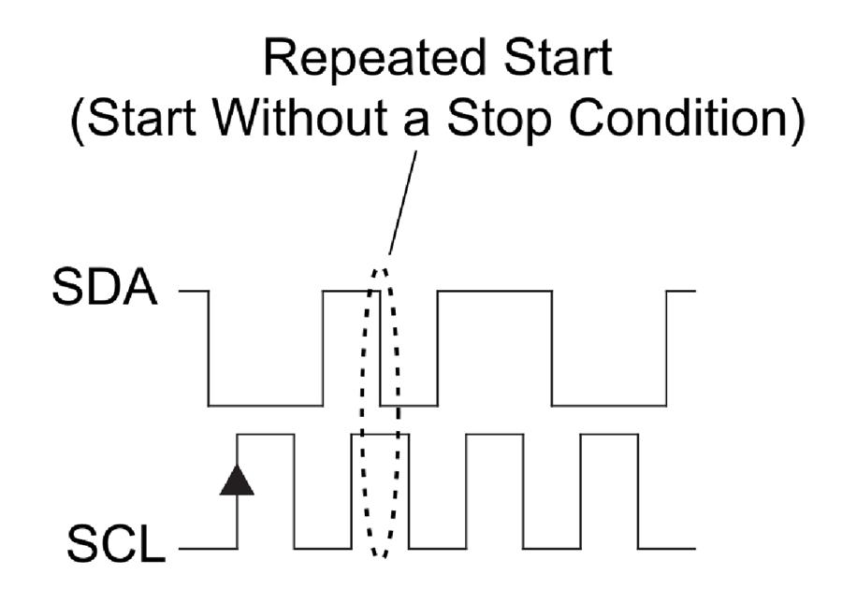
Building an I2C Packet
https://www.analog.com/en/resources/technical-articles/i2c-primer-what-is-i2c-part-1.html

Slide 33
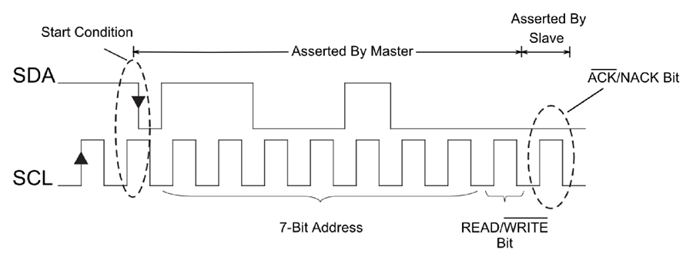
Building an I2C Packet
https://www.analog.com/en/resources/technical-articles/i2c-primer-what-is-i2c-part-1.html

Slide 34
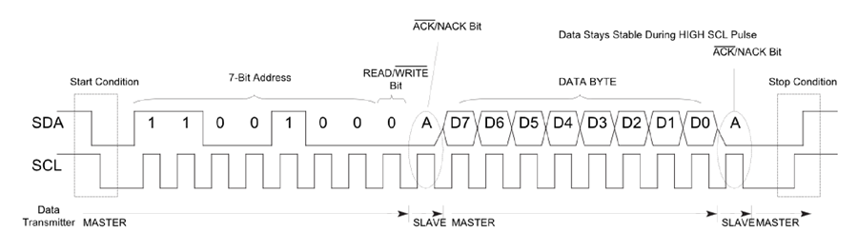
Complete Transaction Example (Write)
https://www.analog.com/en/resources/technical-articles/i2c-primer-what-is-i2c-part-1.html

Slide 35
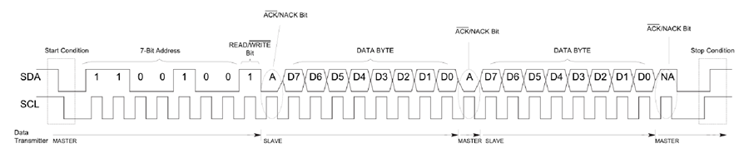
Complete Transaction Example (Read)

Slide 36
…what did I read!?

Slide 37
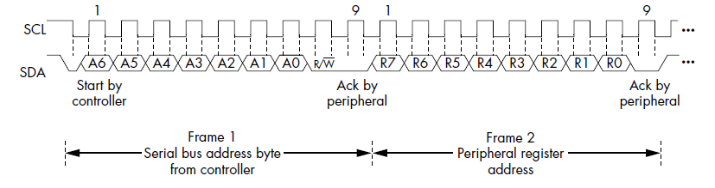
Realistic Read (Repeated Start)

Slide 38
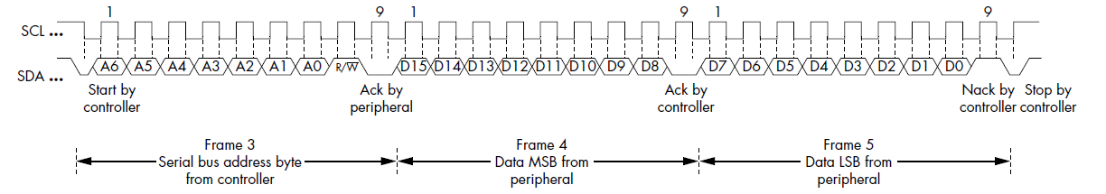
Realistic Read (Repeated Start)

Slide 39
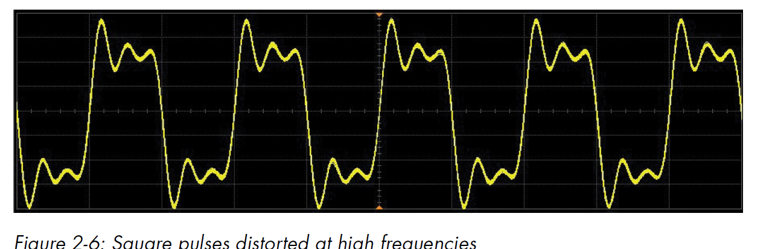
Differential Signals

Slide 40
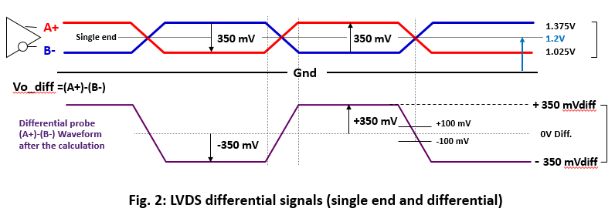
Low Voltage Differential Signaling
Common-Mode Range
Differential Range
https://www.thine.co.jp/en/contents/detail/serdes-lvds.html

Slide 41
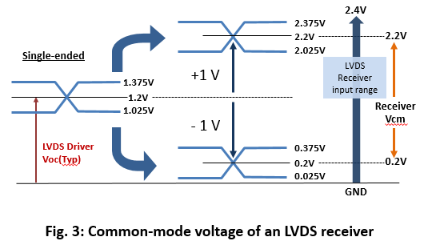
LVDS Receiver Range
https://www.thine.co.jp/en/contents/detail/serdes-lvds.html

Slide 42
LVDS “Protocol”
LVDS is a signaling method – lots of the same protocols run over LVDS just to run faster / more robustly
Some protocols only run over LVDS

Slide 43
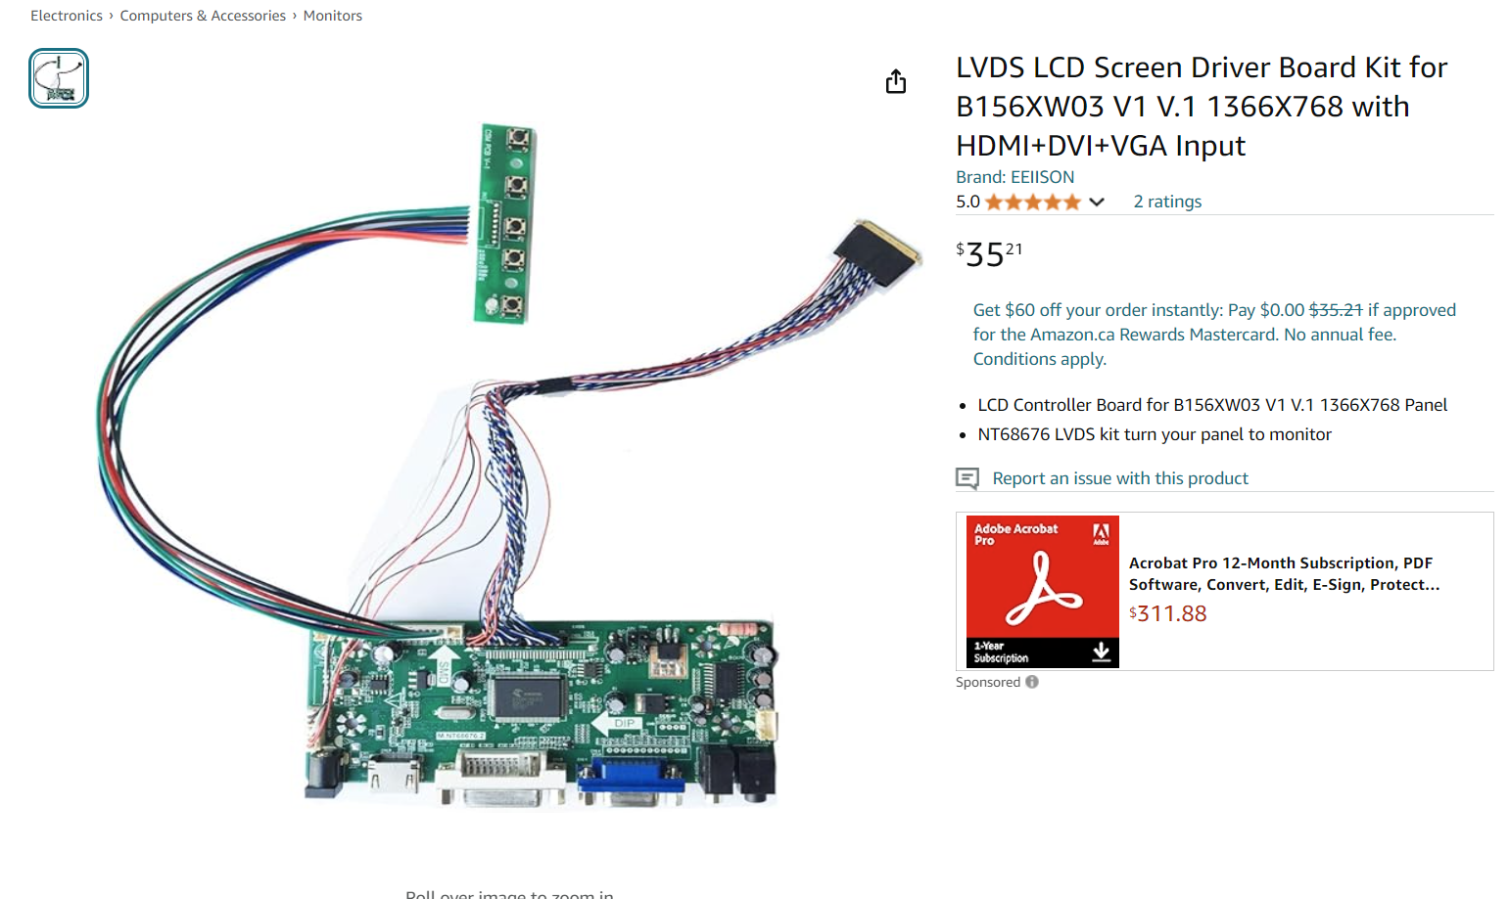
LVDS LCDs

Slide 44
Differential Signaling
LVDS is one example of differential signalling
LVDS is most likely range you run into within a PCB, but others are around, including:
USB
DDR memory (some signals are differential)
RS485 (normally off-board)

Slide 45
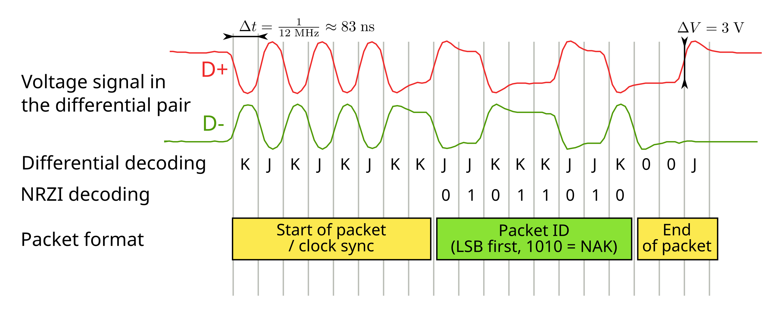
Other Differential Signals: USB
https://en.wikipedia.org/wiki/USB_communications#/media/File:USB_signal_example.svg

Slide 46
Summary
Most signals broken into Synchronous vs. Asynchronous
Asynchronous: No clock in common, all based on timing
Synchronous: Clock common between sides
Went over UART, SPI, I2C, and LVDS
Discussed common baud rates you might see to help in identifying signals

